Slide 1
Collaborative AI – 236203 Intro to AI overview
Slides adapted from ai.berkeley.edu by
Dan Klein, Pieter Abbeel and Anca Dragan
and from Shaul Markovitz @ Technion

Slide 2
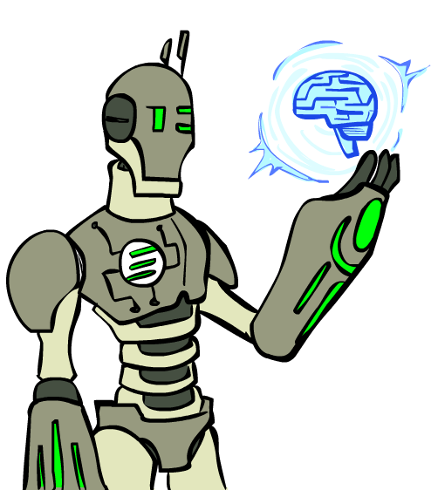
Today’s lecture
Philosophical discussion on AI
Progress in AI
The architecture of an intelligent agent
Problem-Solving Agents
Intro to RL
Notes:
Many you have seen before.
Unified formalism leading to A* search (search guided by heuristic)

Slide 3
Philosophical discussion on AI

Slide 4

What is artificial intelligence?
“Artificial intelligence (AI) is intelligence demonstrated by machines” [wikipedia]
“Artificial intelligence (AI) refers to the simulation of human intelligence in machines… [it refers to] any machine that exhibits traits associated with a human mind such as learning and problem-solving” [investopedia]
“A CS discipline that is concerned with developing algorithms to acquire, reason and learn data to solve complex problems” [Shaul Markovitz]

Slide 5
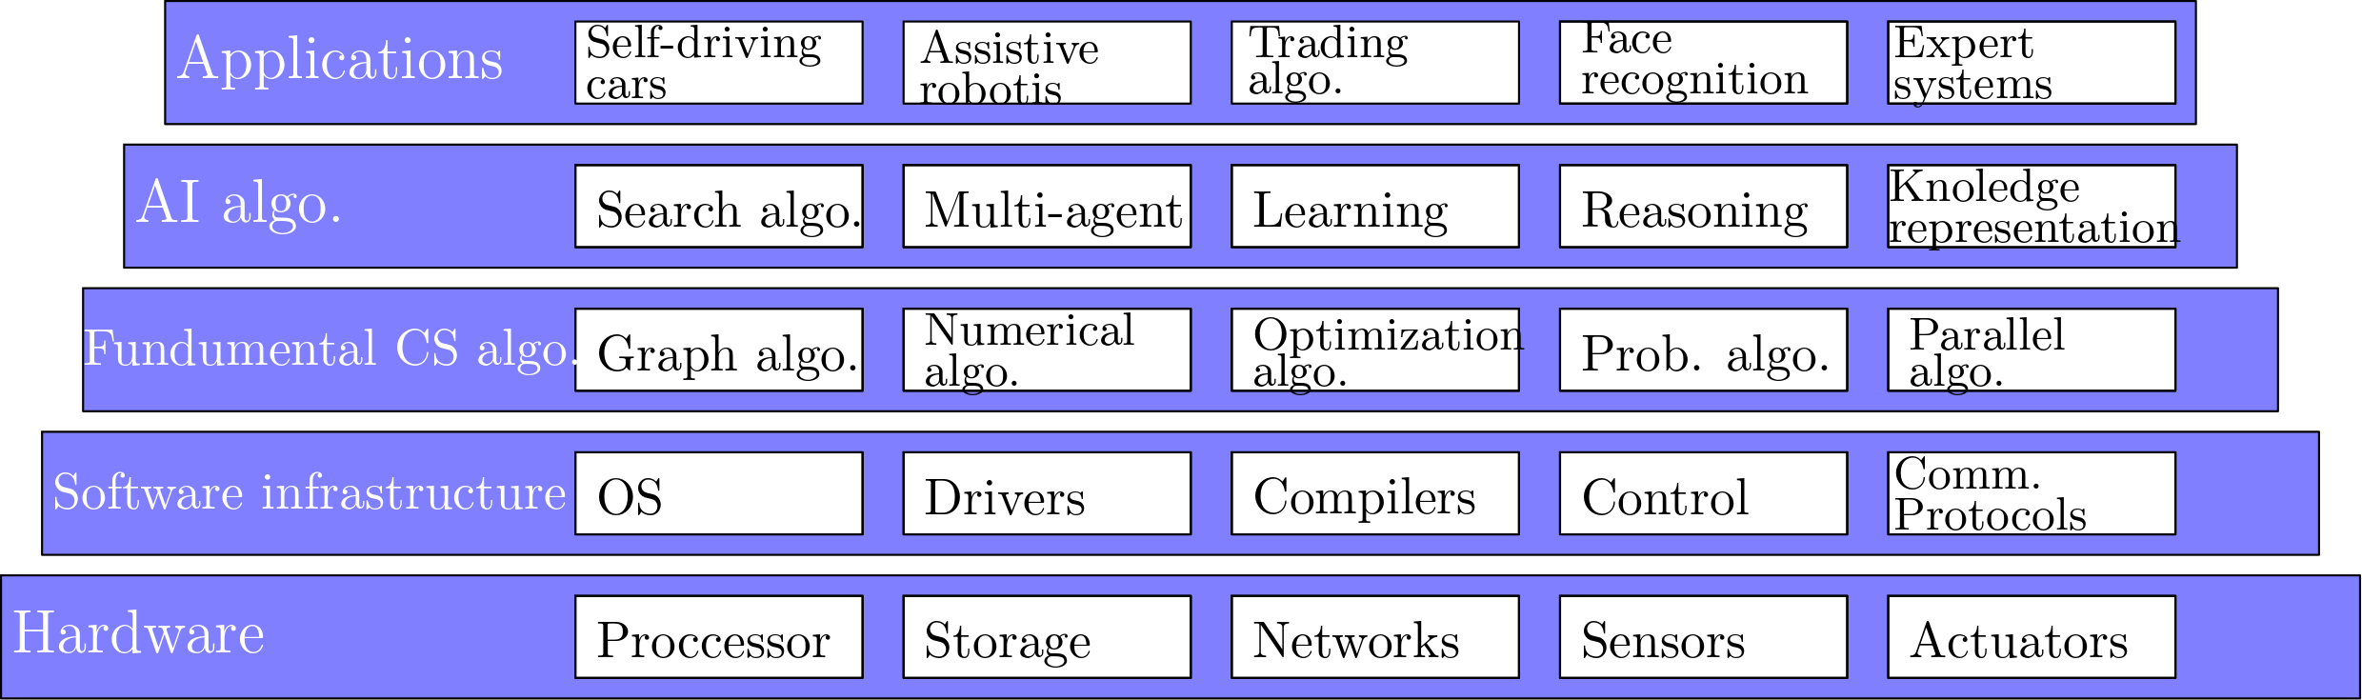
CS and AI

Slide 6
Progress in AI

Slide 7
Humans vs. Computers
What tasks are computers clearly better than humans?
Arithmetic computation, systematic search, storing and retrieving data, boredom resistance, not pressurable, handling big data
What tasks are humans clearly better than computers?
World model, reasoning, language processing
What about
Image analysis, pattern recognition, learning

Slide 8
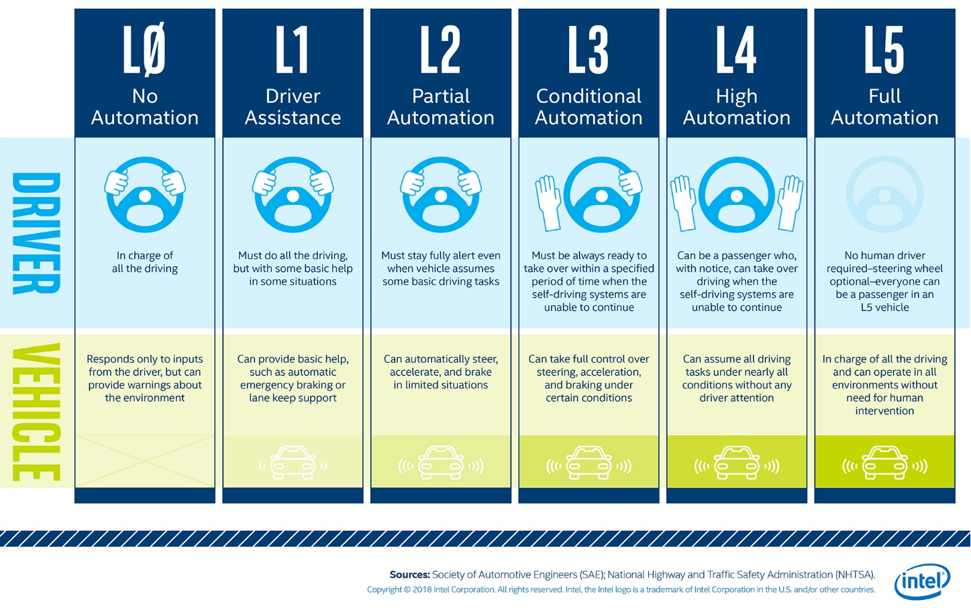
Autonomous agents (self-driving cars)

Slide 9
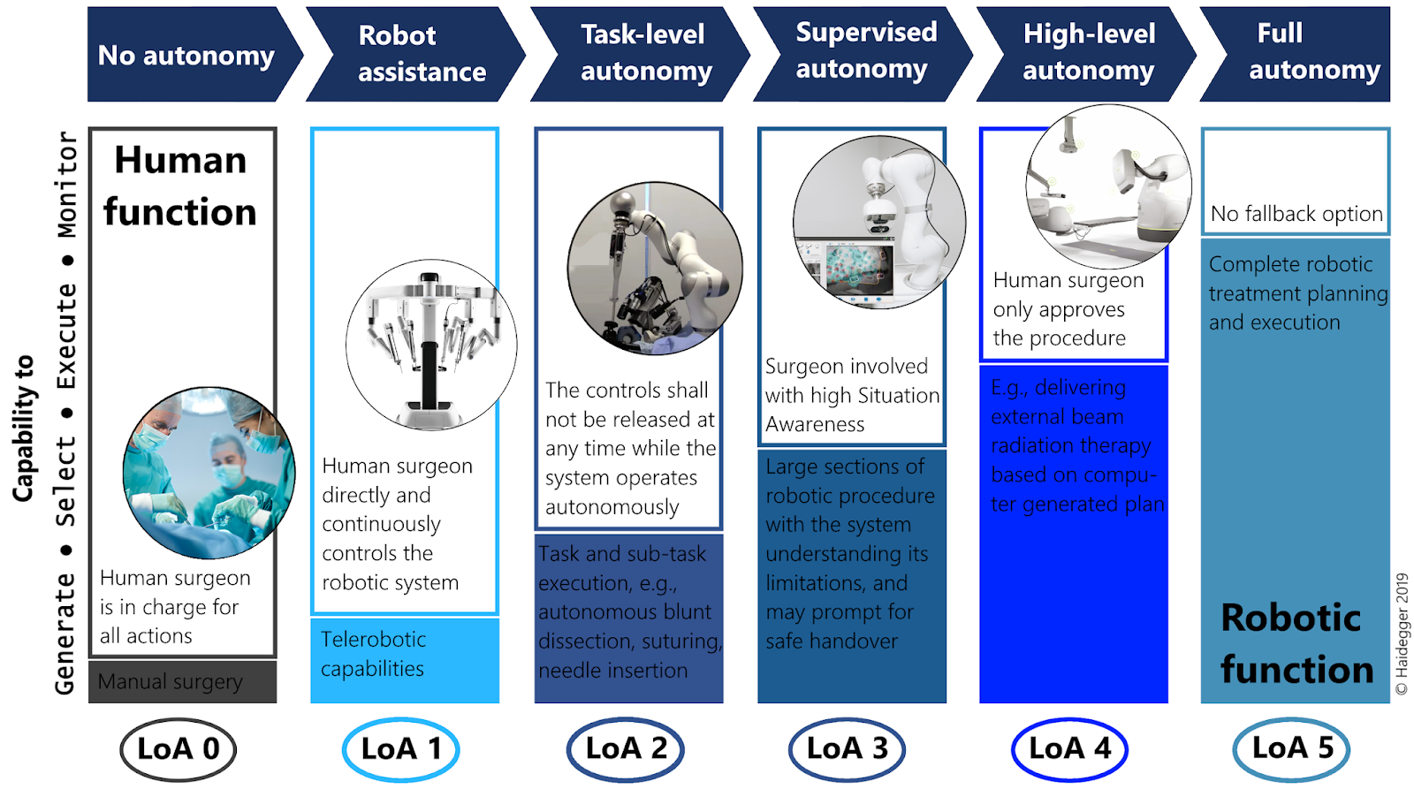
Autonomous agents (robotic surgery)
Adapted from http://surgrob.blogspot.com/2019/05/level-of-autonomy-for-surgical-robotics.html

Slide 10
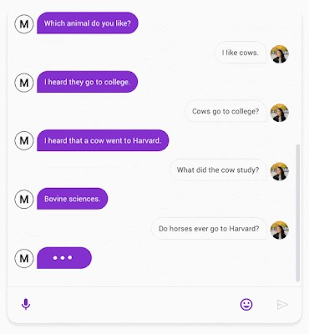
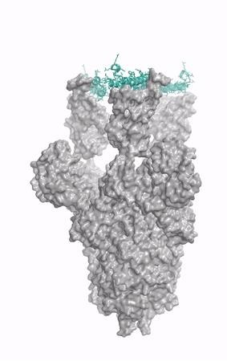
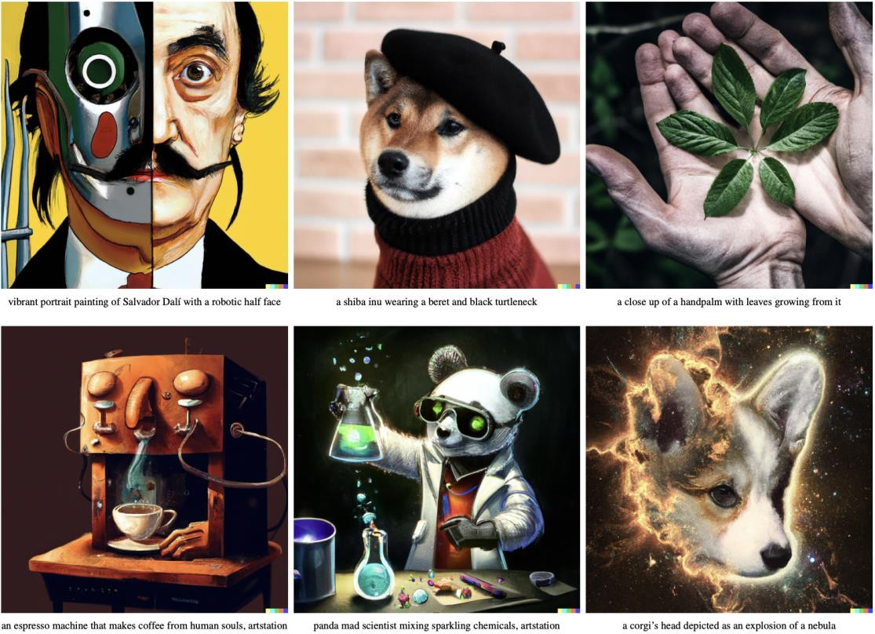
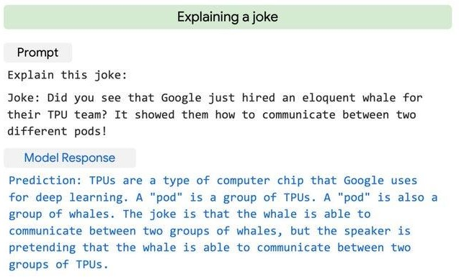
image credit: UW IPD

Slide 11

AlphaGo - The Movie

Slide 12
Architecture of an autonomous intelligent agent

Slide 13
Rational Decisions
We’ll use the term rational in a very specific, technical way:
Rational: maximally achieving pre-defined goals
Rationality only concerns what decisions are made
(not the thought process behind them)
Goals are expressed in terms of the utility of outcomes
Being rational means maximizing your expected utility
Notes:
Not about building machines that don’t get angry
Example of utilities. 10 for A, 1 for each Friday with friends

Slide 14
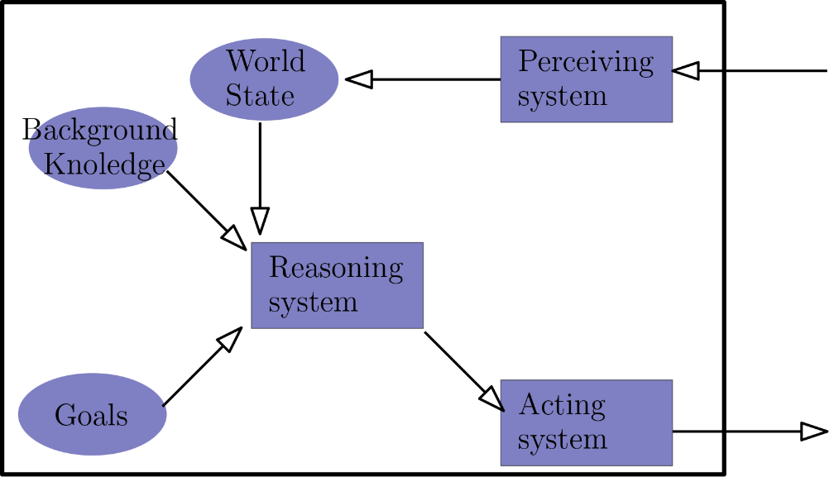

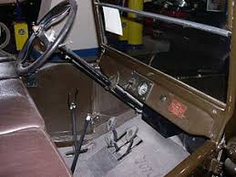
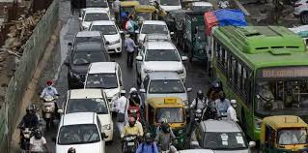
Rational agent
In a complex environment we can’t encode all state + goal pairs to actions
A rational agent uses its model of the word coupled with a reasoning system to plan a sequence of actions that will lead to the goal while maximizing its expected utility

Slide 15

Each one of the components of a rational agent is a subdiscipline in AI
ML
Computer Vision, NLP…
Reasoning, search
Robot design

Slide 16

What about more than one agent?
We often have more than one agent
Do they share the same goal? (Cooperative / competitive)

Slide 17
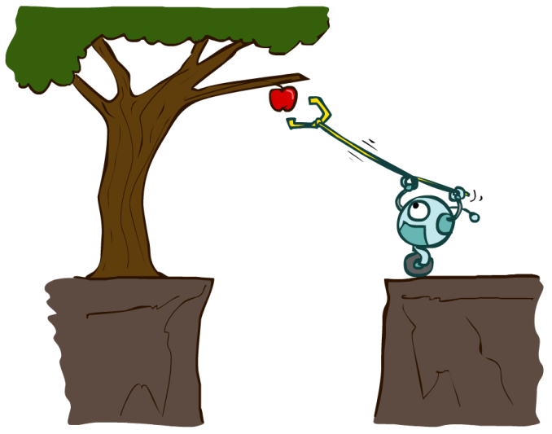
Designing Rational Agents
An agent is an entity that perceives and acts.
A rational agent selects actions that maximize its (expected) utility.
Characteristics of the percepts, environment, and action space dictate techniques for selecting rational actions
Sensors
Agent
Percepts
Environment
?
Actuators
Actions

Slide 18
How do we design the rational agent’s decision procedure?
An agent’s decision procedure maps a world’s state and a desired goal to an action
We can hardcode the mapping
May be an infinite table
We can hardcode the mapping
May (still) be an infinite table
This is called a reflex agent
Sensors
Agent
Percepts
Environment
?
Actuators
Actions

Slide 19
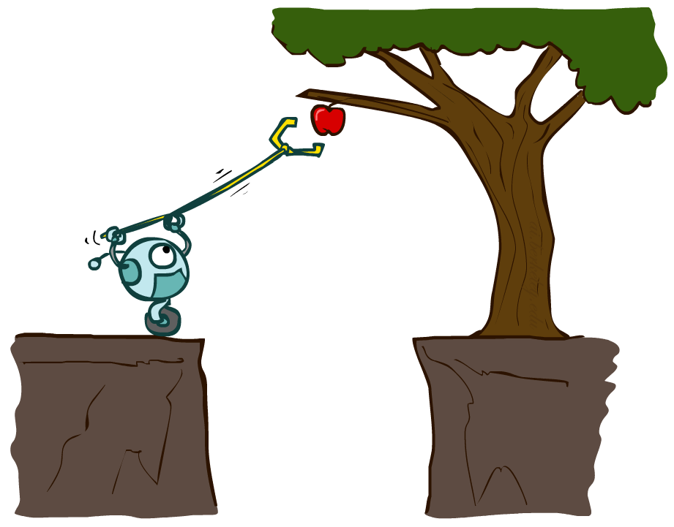
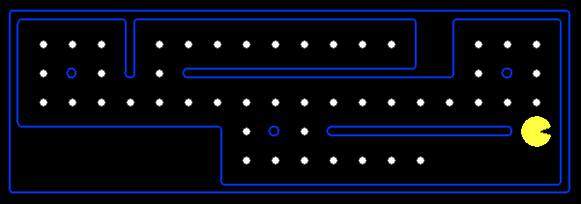
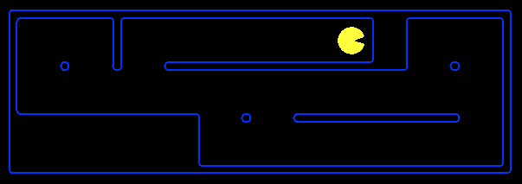
Planning Agents
Planning agents:
Ask “what if”
Decisions based on (hypothesized) consequences of actions
Must have a model of how the world evolves in response to actions
Must formulate a goal (test)
Consider how the world WOULD BE
Optimal vs. complete planning
Planning vs. replanning
Notes:
You cold figure out the consequences by doing it. But instead, planning considers what the world would be without actually doing it.
Simulate many games, execute one. Doesn’t do it in the world, does it in the model.
Consequences of action.
Complete – a solution; optimal – best

Slide 20
Problem-Solving Agents

Slide 21

How do we formalize a search problem?

Slide 22

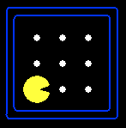





Search Problems
A search problem consists of:
A state space
A successor function
(with actions, costs)
or a set of operators
A start state and a goal test
A solution is a sequence of actions (a plan) which transforms the start state to a goal state
“N”, 1.0
“E”, 1.0
Notes:
Abstraction. Useful for later topics.
Goal test – sometimes more than one state that satisfies having achieved the goal, for example, “eat all the dots”

Slide 23

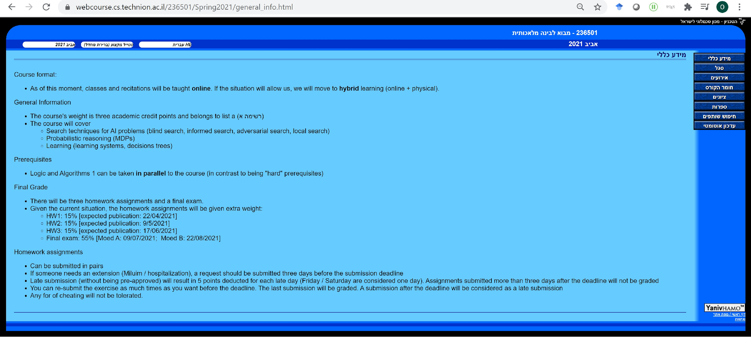
Example: searching the internet
Problem: Given the Technion’s homepage, find the series of clicks that will get you to the homepage of Intro To AI
State space: all URLs
Successor function: for each page the set of successors is defined by the links available at that page (cost = 1)
Start state: https://www.cs.technion.ac.il/
Goal state: https://webcourse.cs.technion.ac.il/236501/

Slide 24

Search Problems Are Models
Models aren’t perfect
Too detailed, you can’t solve
Not detailed enough, doesn’t solve

Slide 25
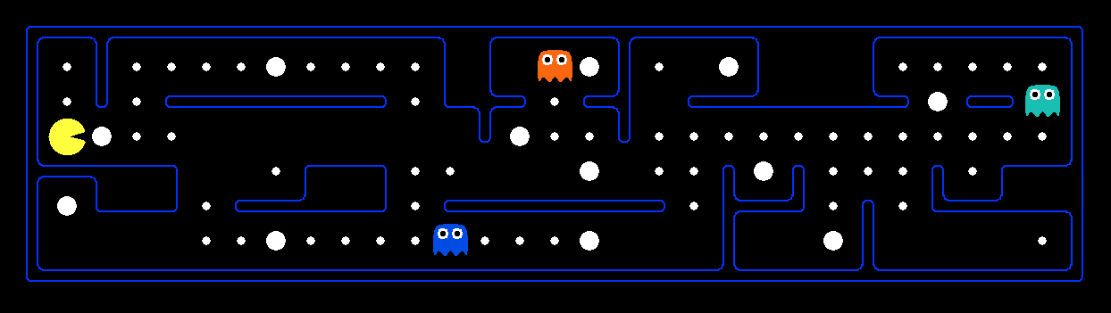
What’s in a State Space?
The world state includes every last detail of the environment
A search state keeps only the details needed for planning (abstraction)
Problem: Path finding
States: (x,y) location
Actions: NSEW
Successor: update location only
Goal test: is (x,y)=END
Problem: Eat-All-Dots
States: {(x,y), dot booleans}
Actions: NSEW
Successor: update location and possibly a dot boolean
Goal test: dots all false
Notes:
Wrong example for “eat-all-dots”: (x, y, dot count). Need bool.
World >= State
Walls? Part of successor.

Slide 26
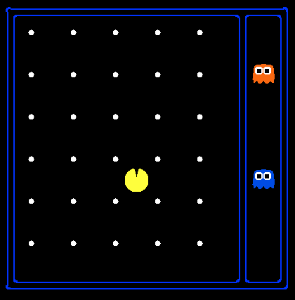
State Space Sizes?
World state:
Agent positions: 12X10 = 120
Food count: 30
Ghost positions: 12
Agent facing: NSEW
How many
World states?
120x(2³⁰)x(12²)x4
States for path finding?
120
States for eat-all-dots?
120x(2³⁰)
Notes:
12x10 grid

Slide 27
Some assumptions
Set of actions is finite and bounded by some constant
In practice, they are often parametrized and thus infinite (e.g., steering angle of a car)
In such settings we can discretize the set of actions
State of agent is observable
i.e., agent knows its state
Actions are deterministic
i.e., agent knows what will happen when it does something
We will relax some of these assumptions along the course
Notes:
12x10 grid

Slide 28
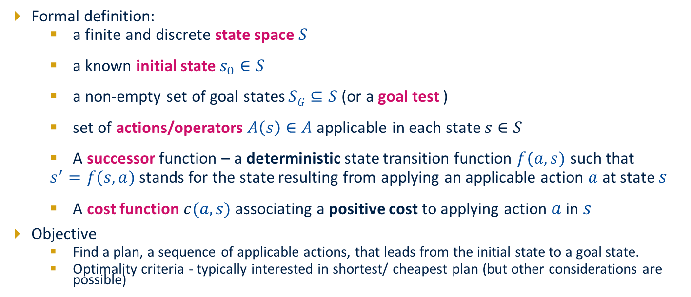
State Space Search Problem : Classical Planning

Slide 29
Formalizing a search problem

Slide 30
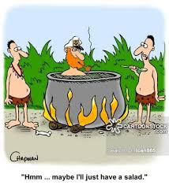
Example: Missionaries and cannibals problem
Problem:
3 missionaries and 3 cannibals must cross a river using a boat that carries at most 2 people
If there are missionaries present on the bank, they cannot be outnumbered by cannibals (if they were, the cannibals would eat the missionaries)
The boat cannot cross the river by itself with no people on board
How do we represent the search problem?

Slide 31

Example: Missionaries and cannibals problem
Take (1):
A state is a 7-tuple
location of person
location of boat
Start state:
Goal state:
How many states do we have?
Unnecessary information
We don’t care which missionary / cannibal is on which side
We don’t care about the state of the boat while crossing

Slide 32







Example: Missionaries and cannibals problem
Take (2):
A state is a 3-tuple
number of missionaries on left bank
number of cannibals on left bank
location of boat
Start state:
Goal state:
How many states do we have?

Slide 33
What is Reinforcement Learning?

Slide 34

Three Approaches to Problem Solving
Programming: specify control by hand
Model-based solving: specify problem model by hand, derive control automatically (e.g., planning)
Learning: learn control from experience
So far, we have mainly focused on model-based solutions.

Slide 35

What is Reinforcement Learning (RL) ?
In a nutshell, RL is the study of agents and how they learn by trial and error. It formalizes the idea that rewarding or punishing an agent for its behavior makes it more likely to repeat or forego that behavior in the future.

Slide 36
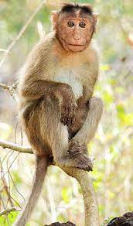

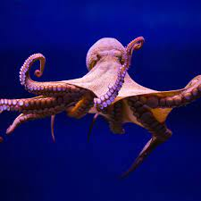
Reinforcement Learning
Reinforcement has been carefully studied by animal psychologists for over 60 years
When learning to crawl, any forward motion is an achievement.
Animals seem to be hardwired to recognize pain and hunger as negative rewards and pleasure and food intake as positive rewards.
Agent must be “hardwired” to recognize that part as a reward rather than as just another sensory input.
Notes:
When you plan you will have to take these into account

Slide 37
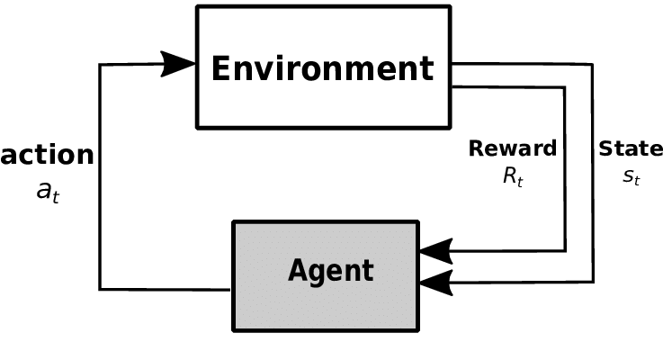
What is Reinforcement Learning (RL) ?
We so far assumed the agent has a complete model of the environment: it knows the reward and transition functions
In RL this assumption is relaxed: agent interacts with the environment and periodically receives rewards (reinforcements)
Use observed rewards to learn an optimal (or nearly optimal) policy
We assume the environment can be modeled as a Markov decision processes (MDPs) (which is not fully known)
Notes:
When you plan you will have to take these into account

Slide 38
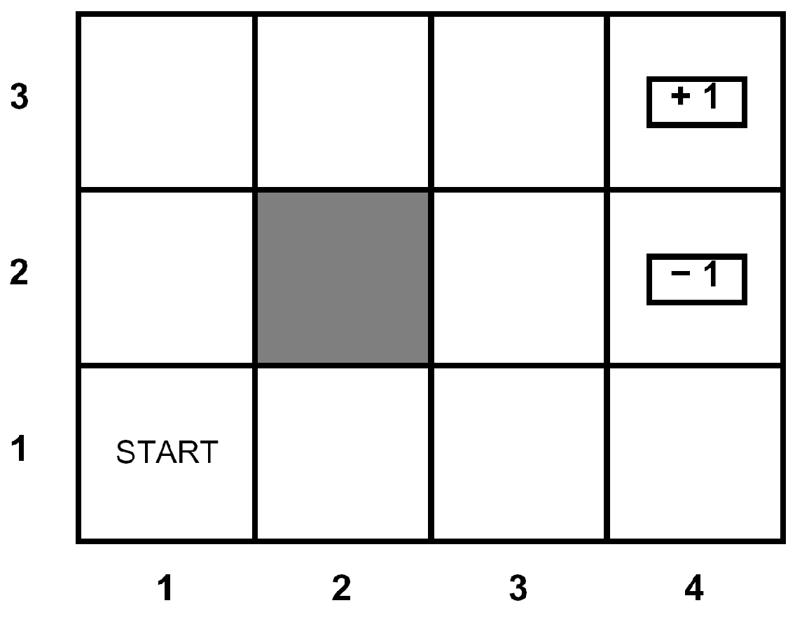





Example: Grid World (revisited)
A maze-like problem
The agent lives in a grid
Walls block the agent’s path
Noisy movement: actions do not always go as planned
80% of the time, North action takes the agent North
10% of the time, North action takes the agent West
10% of the time, North action takes the agent East
If there is a wall in the direction the agent would have been taken, the agent stays put
The agent receives rewards each time step
Small “living” reward each step (can be negative)
Big rewards come at the end (good or bad)
Goal: maximize sum of rewards

Slide 39
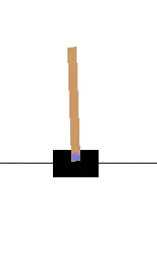
Example: Cart-pole
The agent is the cart, controlled by two actions: moving left or right.
Reward +1 is given at every timestep if the pole remains upright.
The objective is to maximize total reward by preventing the pole from falling over
The episode ends when the pole is more than 15 degrees from the vertical or the cart moves more than 2.4 units from the center

Slide 40
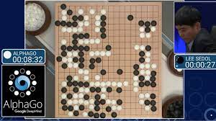
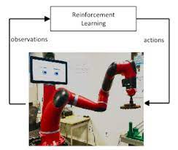
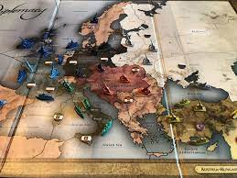
Applications for RL
Game playing
Checkers (Samuel 1952)
Backgammon (Tesauro 1990,1992)
Go and Atari games (Deep Mind 2016)
Poker (Brown and Sandholm, 2017)
Robotic control
From cart-pole (Michie and Chambers 1968) to helicopter flight (Bagnel and Schneider 2001, Ng et al. 2003, Coates et al, 2009)
Manipulation (Levine et al, 2016)
Many more
Any domain in which it is possible to collect experiences and associate rewards to behaviors

Slide 41
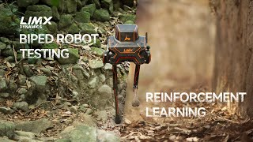
RL Application - Robotic control

Slide 42
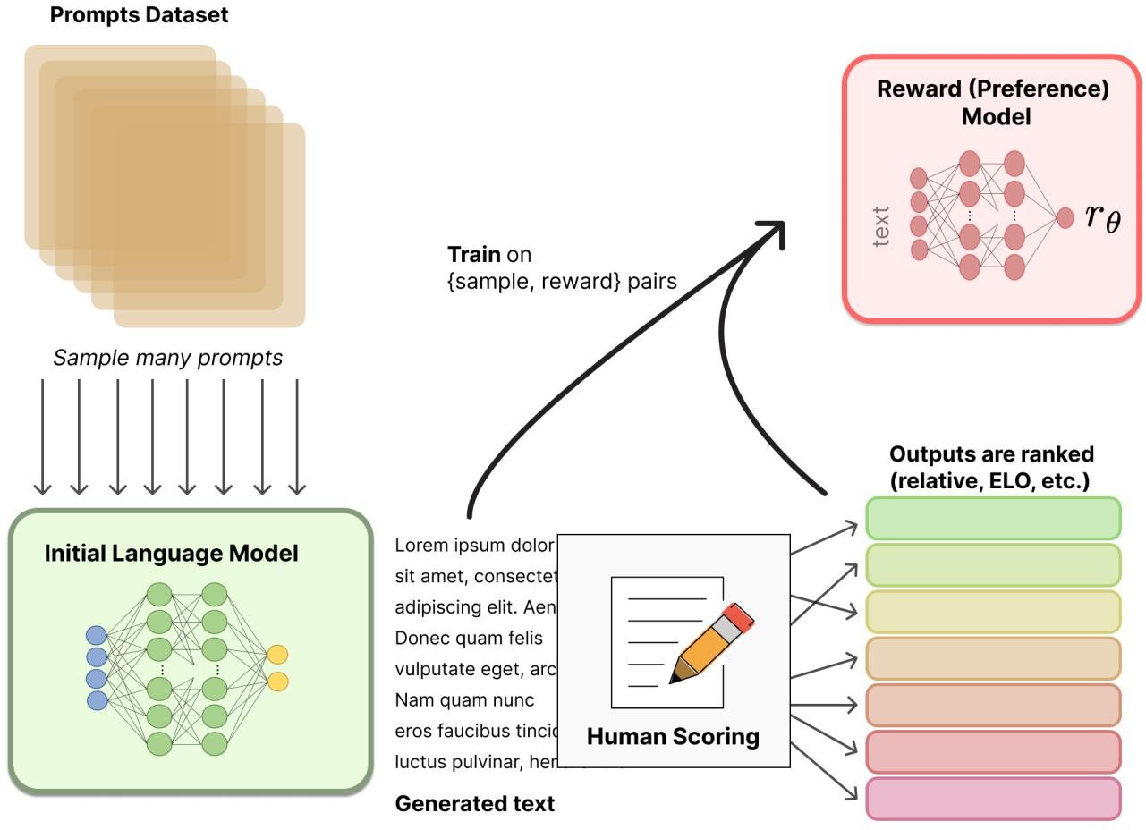
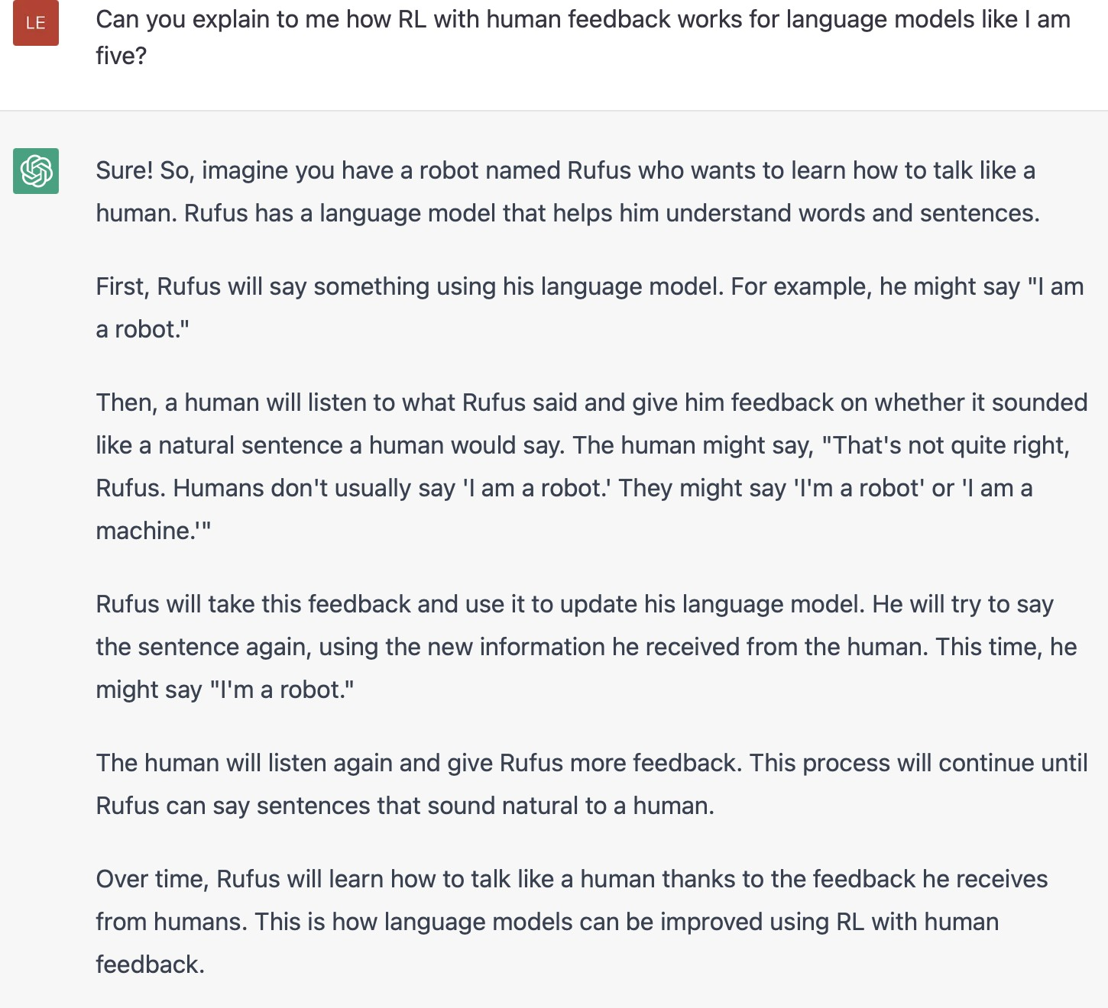
RL Application - language models

Slide 43
















RL Application - image generation
DDPO
(RL)
DDPO (RL)
DDPO (RL)
“a dolphin riding a bike”
Kevin Black*, Michael Janner*, Yilun Du, Ilya Kostrikov, Sergey Levine. Training Diffusion Models with Reinforcement Learning. 2023.

Slide 44
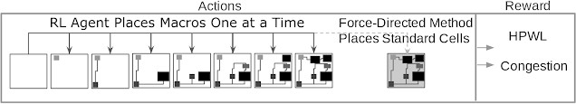
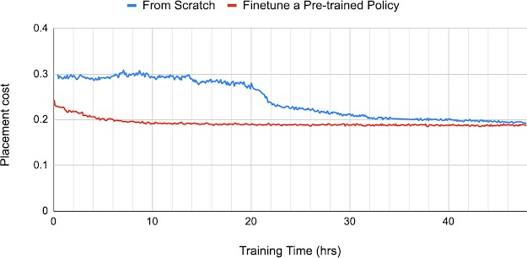
RL Application - chip design
Source: https://ai.googleblog.com/2020/04/chip-design-with-deep-reinforcement.html

Slide 45
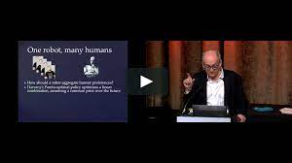
Opportunities and Challenges of RL
Opportunities:
A general way to build AI systems
No need to tell the agent how to behave – only provide a reward function (which is often much easier)
Particularly true for simulated environments in which it is easy to gain experiences (i.e., collect data)
Challenges:
Actions have non-deterministic effects, which are initially unknown
Sparse rewards: rewards / punishments are infrequent:
often at the end of long sequences of actions
Credit association problem: which of the actions performed was responsible for success/failure
World is large and complex
Data is hard to acquire
Rewards are not trivial to design
https://vimeo.com/389553895

Slide 46
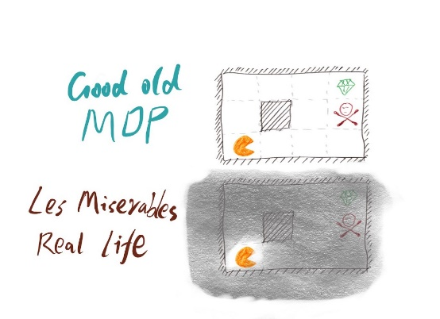
MDPs (reminder)
https://medium.com/@ngao7/reinforcement-learning-model-based-adp-learner-with-code-implementation-6ad73867fb1e

Slide 47

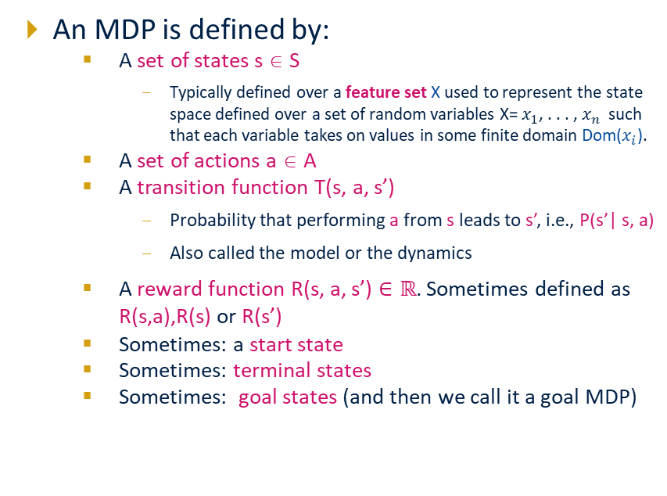
Markov Decision Processes (reminder)
Notes:
In search problems: did not talk about actions, but about successor functions --- now the information inside the successor function is unpacked into actions, transitions and reward
Write out S, A, example entry in T, entry in R; note: T has to some up to 1 over all s’s
Reward function different from the book : R(s,a,s’)
In book simpler for equations, but not useful for the projects.
Need to modify expectimax a tiny little bit to account for rewards along the way, but that’s something you should be able to do, and so you can already solve MDP’s (not in most efficient way)

Slide 48

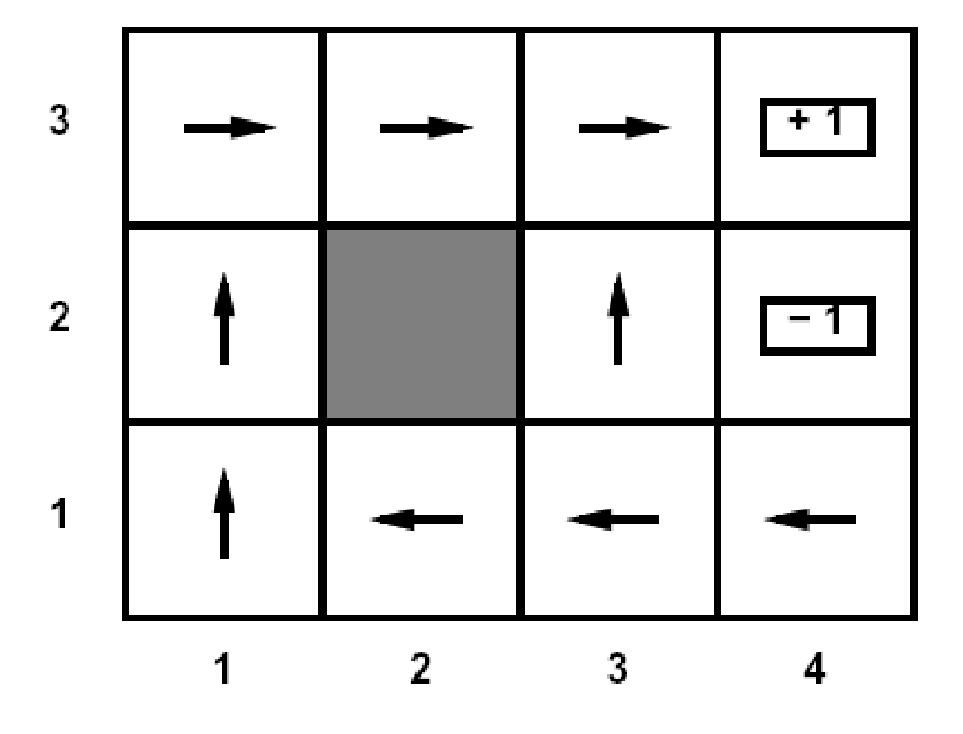
Policies (reminder)
For MDPs, we seek an optimal policy π*: S → A
A policy π specifies an action for each state
An optimal π* is a policy that maximizes expected utility if followed
Optimal policy when R(s, a, s’) = -0.03 for all non-terminals s

Slide 49
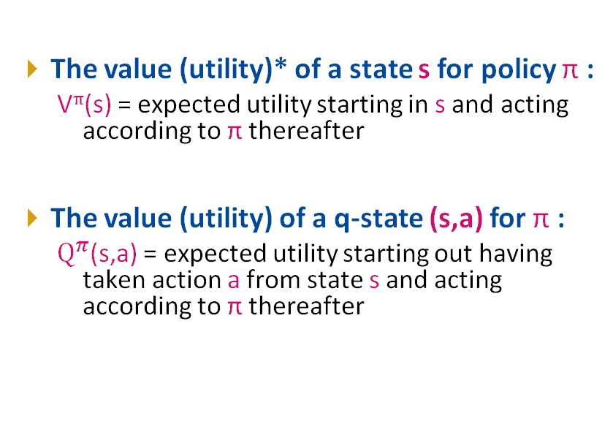
Value for a given policy
s
s is a state
a
(s, a) is a q-state
s, a
s,a,s’
(s,a,s’) is a transition
s’
*(V and U are used interchangeably)
Notes:
[Note: this demo doesn’t show anything in action, just pops up V and Q values.]

Slide 50
Optimal Quantities
An optimal policy:
π*(s) = optimal action from state s
The optimal value (utility) of a state s:
V*(s) = expected utility starting in s and acting optimally
The optimal value (utility) of a q-state (s,a):
Q*(s,a) = expected utility starting out having taken action a from state s and (thereafter) acting optimally
s
s is a state
a
(s, a) is a q-state
s, a
s,a,s’
(s,a,s’) is a transition
s’
Notes:
[Note: this demo doesn’t show anything in action, just pops up V and Q values.]

Slide 51
Problem Formulation and Solution Approaches

Slide 52
Problem Definition
Assuming the world behaves (and can be modeled) as an MDP (restrictive?)
The agent has partial or no knowledge of environment, but can act in the world and observe states and reward
Find a policy that maximizes expected utility

Slide 53
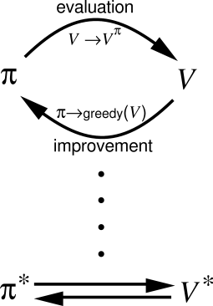
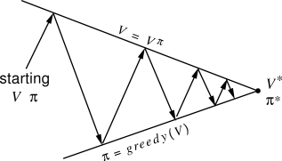
RL Solutions
Two basic components
Policy evaluation / passive RL:
How good is a given policy
The agent has a fixed policy and tries to learn the utilities of states by observing the world go by
Analogous to policy evaluation
Often serves as a component of active learning algorithms
Policy improvement / control / active RL
What is a good/optimal policy
The agent tries to find an optimal policy (or at least good policy) by acting in the world
Analogous to solving the underlying MDP, but without first being given the MDP model

